Slide 1
IT Wiring
综合布线

Slide 2

Overview
Agenda
Background and Requirement
System Design
Project Schedule
BOM and Product Introduction
ITR Brief Introduction

Slide 3
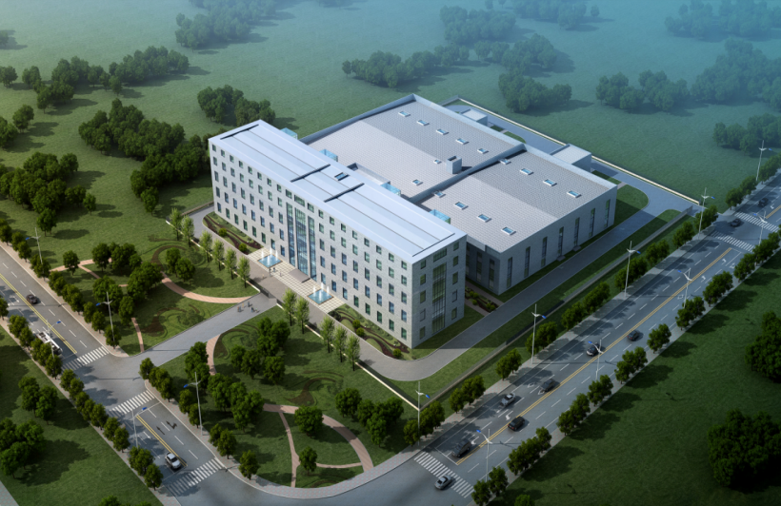
Overview
EUROIMMUN is planning to build a new plant in Tianjin China.
The whole of IT infrastructure is scheduled to design in two stages.
Stage I: Main parts of IT infrastructure that include but not limited to IT Room, CCTV System, Access Control System, Electric Fence and Backbone of Cabling System.
Stage II: Rest parts of IT infrastructure that include but not limited to Data Network System, Wireless Network System, Communication System and Rest Parts of Cabling System.
Goal
The foundation of IT infrastructure must be done in Stage I, the security men can be working.
Aerial View of New Plant of EUROIMMUN

Slide 4
Overview
Agenda
Background and Requirement
System Design
Project Schedule
BOM and Product Introduction
ITR Brief Introduction

Slide 5
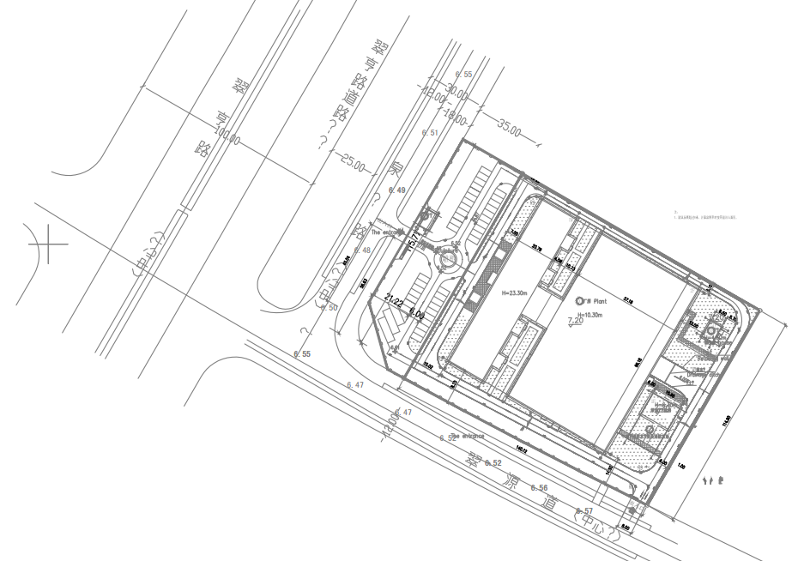
The Whole of Layout of New Plant
There are four areas in this new plant which include Parking, Office, Workshop and Warehouse.
: Guard room
: Parking Area
: Office Building Area
: Workshop Building Area
: Warehouse Area
Note:
Warehouse Area is not included in this design.

Slide 6
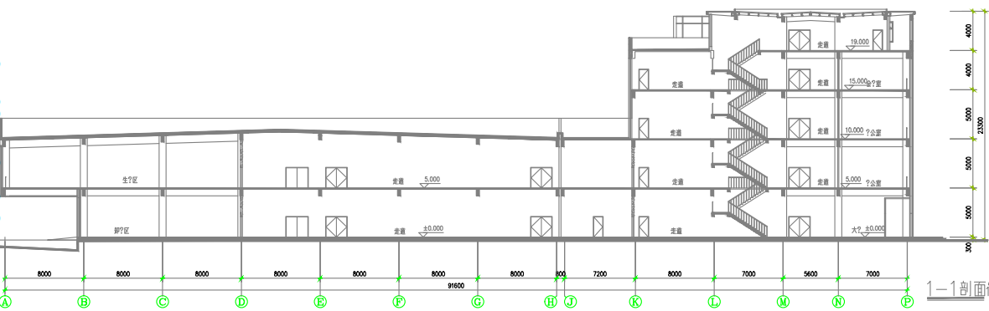
Sectional Elevation of New Plant
Outdoor
1.Parking Area
Indoor
1.Guard Room
- Total of one room.
2.Office Building Area
- Total of five floors.
- Total of 13110m², each floor is 95m x 27.6m.
- Each floor high is 5m.
3.Workshop Building Area
- Total of two floors.
- Total of 10868m², each floor is 96m x 56.6m.
- Each floor high is 5m.
4.Warehouse Area
- N/A.

Slide 7
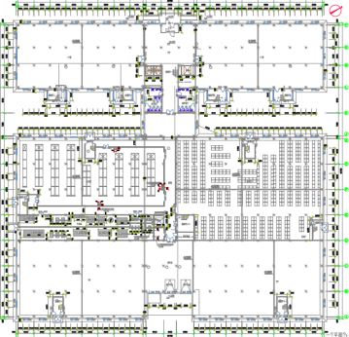
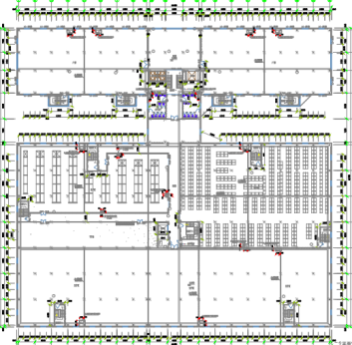
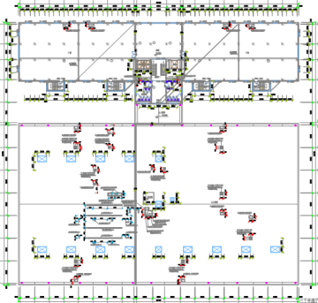
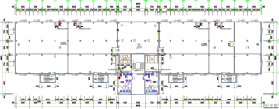
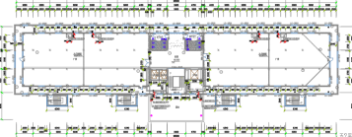
Layouts of Office and Workshop Areas
Office Building Area - F1
&
Workshop Building Area - F1
Office Building Area - F2
&
Workshop Building Area - F2
Office Building Area - F3
&
Workshop Building Area - F2 Roof
Office Building Area - F4
Office Building Area - F5

Slide 8
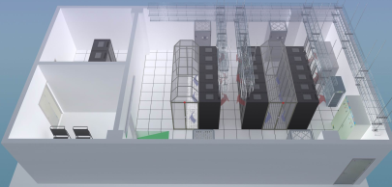
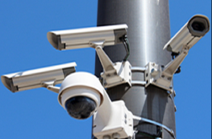
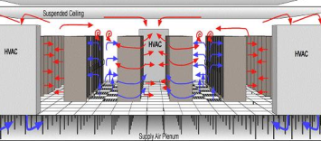
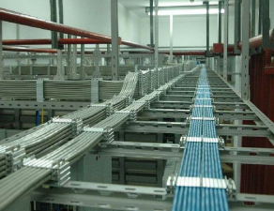
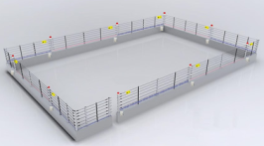
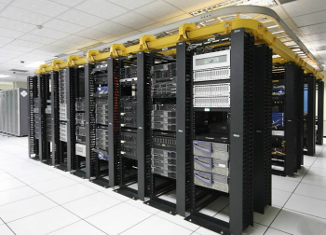

Requirement
EUROIMMUN requested for proposal of IT infrastructure for all areas except warehouse in this project.
This request is only for Stage I.
IT infrastructure consists of seven parts in Stage I.
IT room building
CCTV system
Access control system
Cabling system (Backbone and used for CCTV & ACS)
Raceway of Cabling system
Network system (Used for CCTV & ACS)
Electric fence system

Slide 9
Overview
Agenda
Background and Requirement
System Design
Project Schedule
BOM and Product Introduction
ITR Brief Introduction

Slide 10
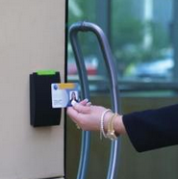
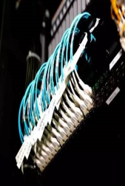

Overview of Design
Based on requirements of Stage I, we have designed the whole of IT infrastructure including seven parts as below:
01
02
03
04
05
06
07
IT Room Building
CCTV
System
Access Control
System
Cabling
System
Raceway
Network
System
Electric Fence
System
1.1 Decoration
1.2 Power supply
1.3 UPS
1.4 Air-condition
1.5 EMS
1.6 Fire protection
2.1 IP cameras
2.2 Video 1080p
2.3 Two months records
3.1 IP controllers
3.2 Fingerprint + IC reader
4.1 Cat6 UTP
4.2 Backbone: ring + star
4.3 Backbone: 10G OM3 multimode fiber
5.1 Up-line pulling
5.2 Galvanized metal raceway
6.1 Two layers
6.2 Single 1G multimode fiber uplink
6.3 100M RJ45 port POE access
7.1 Alloy cable
7.2 Six-line fence

Slide 11

1
IT INFRASTRUCTURE
(STAGE I)
IT Room Building

Slide 12
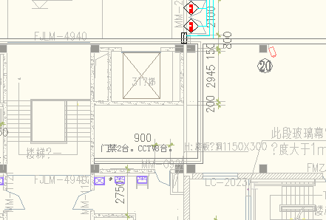
Overview of Design of IT Room Building
IT room as MDF is located at fourth floor in Office Building Area.
IT room is about 50m².
The IT room building consists of six parts as below:
Decoration.
Power supply.
UPS.
Air-condition.
EMS.
Fire protection.
IT Room

Slide 13
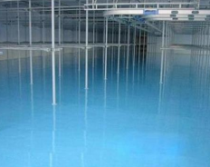
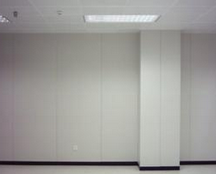
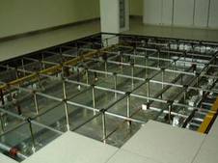
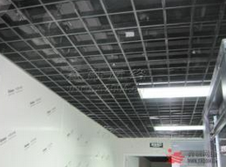

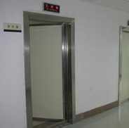
Design of Layout and Decoration
Decoration
Main components include:
Brand: All local.
Ground
Wall
Raised floor
Ceiling
Lighting
Door
Layout Example
Ground
Wall
Raised Floor
Ceiling
Lighting
Door

Slide 14
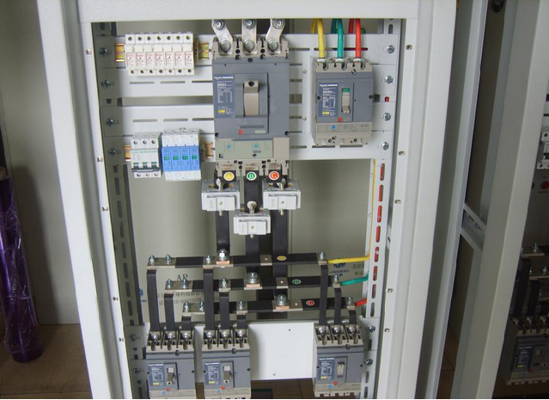
Design of Power Supply
Power Supply
Main components include:
Brand: Almost all local, only breakers are Schneider.
Power distribution box x 1
- Voltage: 380V in, 380V out
- Current: 300A in, 250A out
Output breaker
- 63A x 4 (for Air-condition)
- 32A x 3 (for UPS)
- 16A x 18 (for Rack)
- 10A x 6 (for Normal)
PDU
- 8 ports, C13-C14, 10A
- Two PDU for each rack

Slide 15
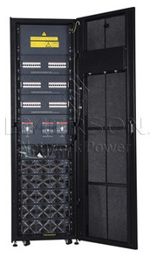
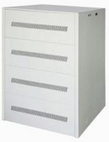
Design of UPS
UPS
Main components include:
Brand: Emerson.
150KVA modular UPS x 1 (30KVA modules in Stage I)
Battery box x 1
12V/120AH battery x 32 (1 hour backup time)
SNMP management card x 1
Note:
We recommend that all of UPS and Batteries must be placed at first floor because of the over-weight.

Slide 16

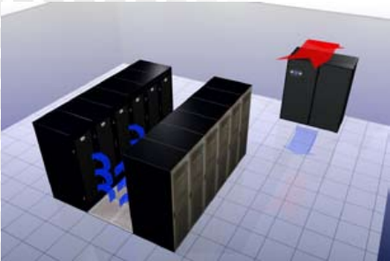
Design of Air-Condition
Air-Condition
Main components include:
Brand: Emerson and Dakin.
Primary AC x 1
- Emerson
- 30KW wind cooling
- Constant temperature and humidity
- Down-supply air
- Auto reboot when repower
Standby AC x 1
- Dakin
- 8.5KW (3P) wind cooling
- Horizontal-supply air
- Auto reboot when repower
Note:
We recommend that all of outdoor units of air-conditions must be placed at first floor because of the water-leakage.

Slide 17
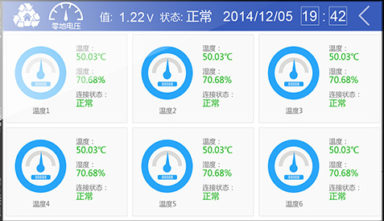
Design of EMS
EMS
Main components include:
Brand: Emerson.
Monitoring appliance x 1
Temperature & Humidity sensor x 6
Fluid sensor x 4
Alarm: E-mail, SMS, acousto-optic

Slide 18
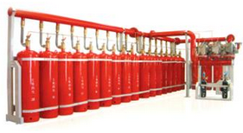
Design of Fire Protection
Fire Protection
Main components include:
Brand: Local.
FM200 x 1
Heptafluoropropane gas x 128KG
Optical smoke detector x 2
Heat detector x 2
Alarm: Acousto-optic

Slide 19
2
IT INFRASTRUCTURE
(STAGE I)
CCTV System

Slide 20
Overview of Design of CCTV System
CCTV system is designed for “office building”, “workshop building” and “outdoor” areas.
All IP cameras with 1080P that they are monitoring key areas as below:
Office and Workshop buildings
The in/out doors (Gun camera)
Elevators (Dome camera)
Outdoor
Parking and main roads (PTZ camera)
Fences (Gun camera)
All cameras of the in/out doors of workshop building are working with passenger flow statistics server.
These cameras can collect passenger flow to help making analysis.
All cameras of fences can set up the virtual fences that could automatically alert to guards if someone
moves into the virtual fences.
Area | Dome Camera | Gun Camera | PTZ Camera
Office | 3 | 55
Workshop |  | 22
Main roads & Parking (outdoor) |  |  | 9
Fences (outdoor) |  | 24

Slide 21
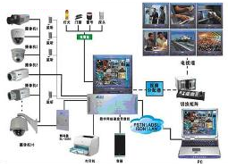
Design of CCTV System
CCTV System
Main components include:
Brand: Either Hikivision or Dahua.
IP camera (powered by POE switch)
- 1080p, 300W pixels
- Dome camera x 3
- Gun camera x 101
- PTZ camera x 9
64-line NVR x 2
6T HDD x 32 (2 months records by H.265)
Passenger flow statistics server x 1
Management software x 1
6-screen 22’’ TV wall x 1
Alarm: E-mail, screen popup, acousto-optic
Note:
All monitors and NVRs are authorized to place at guard room by EUROIMMUN administrator.

Slide 22
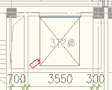
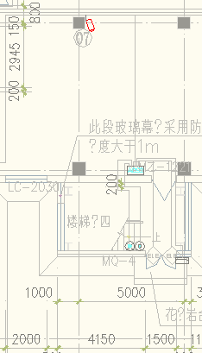
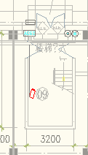

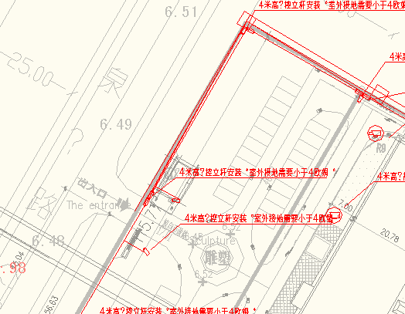
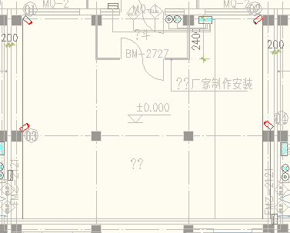
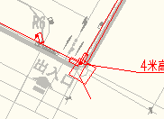
Camera Layout (Key Area Point)
Office Building
Workshop Building
Outdoor
Face to IT room
Elevator
The in/out door
Parking and Main road
The in/out door
Fence

Slide 23
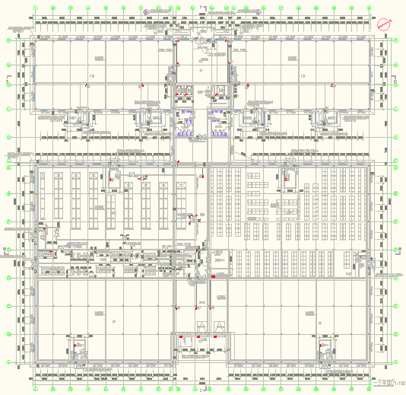
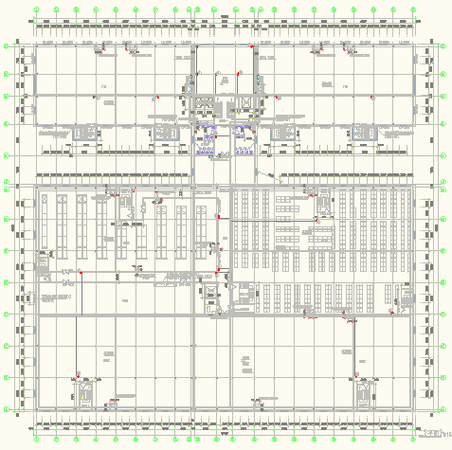
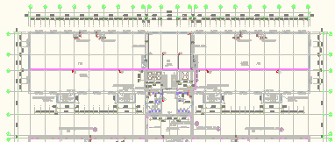
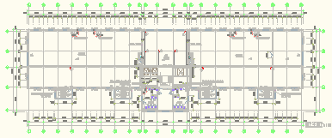
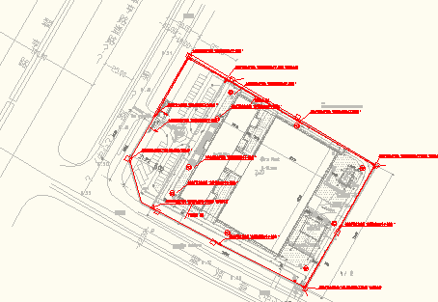
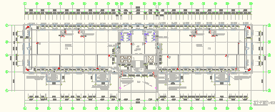
Camera Layout (All)
Office Building - F1
Office Building - F2
Office Building - F3
Workshop Building - F1
Workshop Building - F2
Office Building - F4
Outdoor
Office Building - F5

Slide 24
3
IT INFRASTRUCTURE
(STAGE I)
Access Control System

Slide 25
Overview of Design of Access Control System
Access Control system (ACS) is designed for “office building” and “workshop building” areas.
All controllers that they are managed by IP and controlling key areas as below:
Office and Workshop buildings
The in/out doors
Note: Not designed for IT room.
All readers include both of IC and fingerprint identification functions.
Each portal with double door, our design is as below:
- Single door controller x 1
- Double door electromagnetic lock x 1
- Reader x 1 (for in)
- Button x 1 (for out)
Area | Controller | Reader
Office | 17 | 17
Workshop | 9 | 9

Slide 26
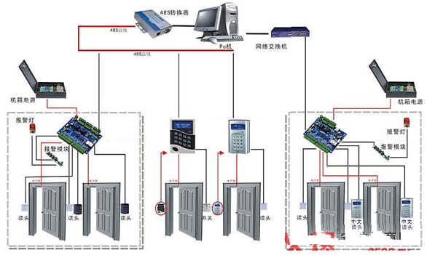
Design of Access Control System
Access Control System
Main components include:
Brand: ZKTeco.
Single door controller x 26
Double door electromagnetic lock x 26
Reader x 26 (IC and fingerprint identification)
Button x 26
Management software x 1
Card issuing x 1
Alarm: E-mail

Slide 27
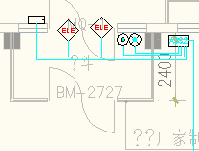
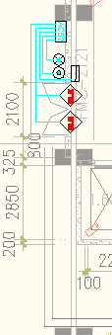
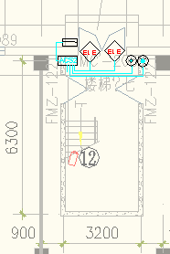

Reader Layout (Key Area Point)
Office Building
Workshop Building
The in/out door
The in/out door

Slide 28
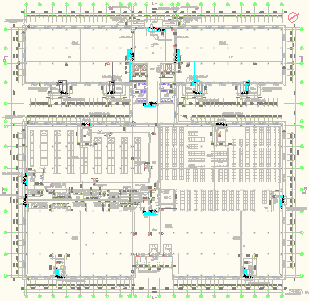
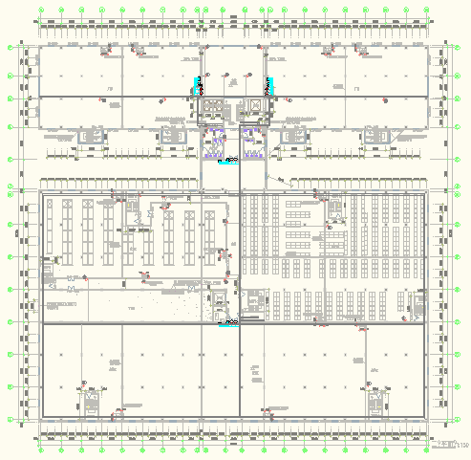
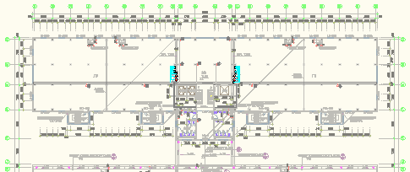
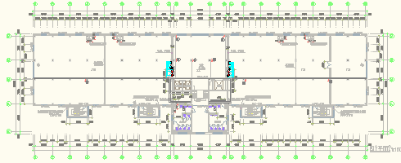
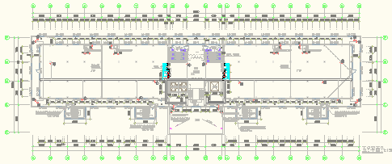
Reader Layout (All)
Office Building - F1
Office Building - F2
Office Building - F3
Workshop Building - F1
Workshop Building - F2
Office Building - F4
Office Building - F5

Slide 29
4
IT INFRASTRUCTURE
(STAGE I)
Cabling System

Slide 30
Overview of Design of Cabling System
Cabling system is designed for CCTV system, Access Control system and backbone between MDF and IDFs. Total number of cabling points of CCTV and ACS is 139.
MDF x 1 (located at fourth floor in Office building)
IDF x 8 (five in Office building, two in Workshop building and one in Guard room)
Cabling system consists of five subsystems:
Working area subsystem
Horizontal area subsystem
Equipment area subsystem
Administration area subsystem
Vertical area subsystem
Working area, Horizontal area, Equipment area and Administration area subsystems:
All cabling points are Cat6 UTP.
Vertical area subsystem:
Backbone between MDF and IDFs: uses Ring + Star structures, 12-core 10G OM3 multimode fiber.
Star structure is designed to redundant link 1+1.

Slide 31
Cabling Points Statistics
IDF# | Area | Qty of Point
IDF1 - F1SR | Camera (Gun Camera) | 8
 | Camera (dome Camera) | 3
 | Door Access (double reader) | 8
IDF2 - F2SR | Camera (Gun Camera) | 10
 | Door Access (double reader) | 3
IDF3 - F3SR | Camera (Gun Camera) | 10
 | Door Access (double reader) | 2
IDF4 - F4SR | Camera (Gun Camera) | 8
 | Door Access (double reader) | 2
IDF5 - F5SR | Camera (Gun Camera) | 19
 | Door Access (double reader) | 2
IDF6 - P1SR | Camera (Gun Camera) | 13
 | Door Access (double reader) | 8
IDF7 - P2SR | Camera (Gun Camera) | 9
 | Door Access (double reader) | 1
IDF8 - Door Guard | Camera (Gun Camera) | 24
 | Camera (PTZ Camera) | 9
 | Total | 139

Slide 32

Cabling Topology

Slide 33









Design of UTP of Cabling System
UTP of Cabling System
Main components include:
Brand: Leoni.
All Cat6
RJ45 information module x 139
2-port faceplate x 139
X86 box x 139
2m patch cord x 300
UTP x 42boxes (305m per box)
24-port patch panel x 9
Cable management x 9
42U rack x 9 (7 in IDFs, 2 in MDF)
12U rack x 1 (wall-mounted, 1 in IDF of 5th floor)

Slide 34



Design of Backbone of Cabling System
Backbone of Cabling System
Main components include:
Brand: Leoni.
Fiber
- 1/10G OM3 multimode
- 12-core
- 3450m length
48-core LC patch panel x 13
Cable management x 13
3m LC patch cord x 30

Slide 35

Design of Fiber for Outdoor CCTV
Fiber for Outdoor CCTV
Main components include:
Brand: Leoni.
For 24 of fence cameras
Fiber
- 1/10G OS2 singlemode
- 6-core
- 2000m length
48-core LC patch panel x 1
Cable management x 1
3m LC patch cord x 50
Fiber-to-RJ45 adapter x 48

Slide 36
5
IT INFRASTRUCTURE
(STAGE I)
Raceway

Slide 37

Design of Raceway
Raceway
Main components include:
Brand: Cablofil and Local.
For IT room
- Up-line pulling
- Cablofil, galvanized metal, mesh
- 300Wx100H
- 30m length
For horizontal area
- Up-line pulling
- Local, galvanized metal, enclosed
- 300Wx100H
- 1665m length

Slide 38





Raceway Layout
Office Building - F1
Office Building - F2
Office Building - F3
Workshop Building - F1
Workshop Building - F2
Office Building - F4
Office Building - F5

Slide 39
6
IT INFRASTRUCTURE
(STAGE I)
Network System

Slide 40
Overview of Design of Network System
Network system is designed for CCTV and Access Control systems.
It consists of two layers:
Core switch
Access switch
All access switches are POE switches which be used for accessing IP cameras and IP controllers, and
could be powered to IP cameras.
Star structure, single core switch, single 1G multimode fiber uplink, 100Mbps RJ45-port access.

Slide 41

Network Topology

Slide 42




Design of Network System
Network System
Main components include:
Brand: Cisco.
Core switch x 1
- Layer 3
- All ports are 1G
- 24-port SFP
Access switch
- Layer 2
- RJ45 port access (100M), SFP port uplink (1G)
- PoE
- 24-port switch x 7
- 48-port switch x 1
1G multimode fiber module x 16
1G RJ45 port module x 8

Slide 43
7
IT INFRASTRUCTURE
(STAGE I)
Electric Fence System

Slide 44


Design of Electric Fence System
Electric Fence System
Main components include:
Brand: Yanrong.
Alloy cable x 4800m
Six-line
Every 75m per zone
Main controller x 1
Management software x 1
Electric fence 2-zone controller x 6
Electric fence 1-zone controller x 3
Warning sign x 120
Alarm: Acousto-optic

Slide 45
Overview
Agenda
Background and Requirement
System Design
Project Schedule
BOM and Product Introduction
ITR Brief Introduction

Slide 46
Project Schedule
1 day
30 days
30 days
5 days
1. Sign contract.
2. Order and delivery equipment.
3. Installation, configuration and testing.
4. Acceptance

Slide 47
Overview
Agenda
Background and Requirement
System Design
Project Schedule
BOM and Product Introduction
ITR Brief Introduction

Slide 48
BOM
Please see the appendix.

Slide 49
Product Introduction
Please see the appendix.

Slide 50
Overview
Agenda
Background and Requirement
System Design
Project Schedule
BOM and Product Introduction
ITR Brief Introduction

Slide 51
Overview
China’s largest and oldest IT turnkey solutions provider, long-term IT-partner in China, for the design, implementation, and ongoing maintenance of their physical IT systems:
IT Workplace Management
Server & Networking
Data Center
Structured Cabling
Physical Security
Voice Systems
Audio-Video

Slide 52





IT Group

Slide 53
Thank You

